Slide 1
Productization of Machine Learning

Slide 2
Introduction to Machine Learning into Production
Machine learning (ML) is maturing from research to applied business solutions. We will be introducing to a systematic approach to operationalizing AI using Machine Learning Operations (MLOps).

Slide 3
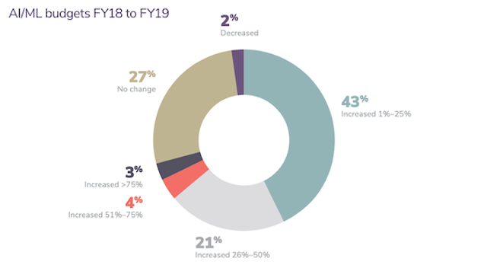
Deployment Gap
More and more companies are developing machine learning models for internal use. But many are still struggling to bridge the gap to practical deployments.
What’s new: Many companies haven't figured out how to realize their AI ambitions, according to a report by Algorithmia, a marketplace for algorithms. Although AI budgets are on the rise, only 22 percent of companies using machine learning have successfully deployed a model, the study found.
Why it matters: AI is rapidly expanding into new applications and industries, and research is making tremendous strides. Yet building successful projects is still difficult. This report highlights both the great value of practical experience in the field and the need to establish effective practices and processes around designing, building, and deploying models.
Add Contents Title
Simple Presentation

Slide 4
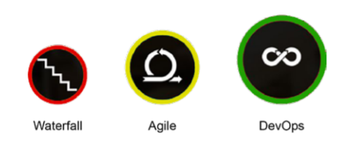
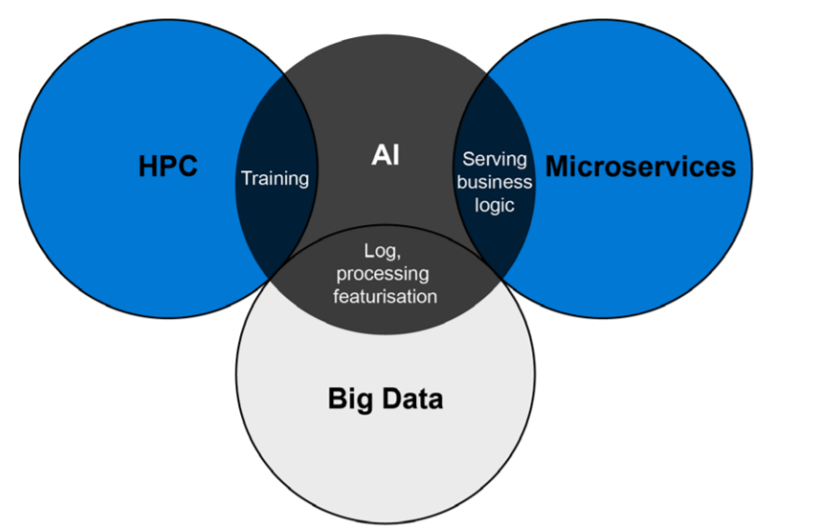
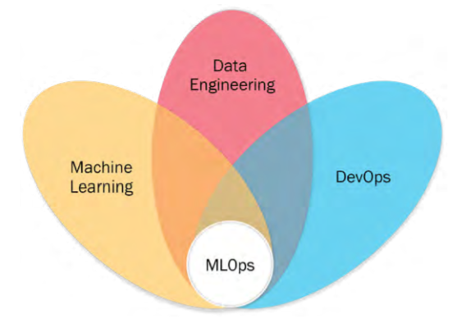
AI-centric applications & Software development evolution

Slide 5
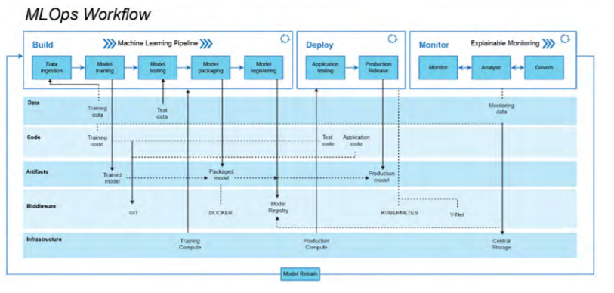
Concepts and workflow of MLOps
This workflow is segmented into two modules:
MLOps pipeline (build, deploy and monitor: the upper layer
Drivers: Data, code, artifacts, middleware and infrastructure – mid and lower layers

Slide 6
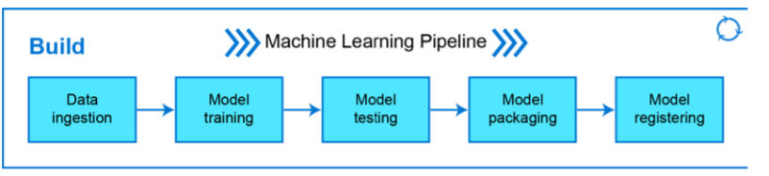
The MLOps pipeline
Build
The build module has the core ML pipeline, and this is purely for training, packaging and versioning the ML models. It is powered by the required compute (for example, the CPU or GPU on the cloud or distributed computing) resources to run the ML training and pipeline:
Data Ingestion
Model Training
Model testing
Model Packaging
Model registering

Slide 7
The MLOps pipeline
Build
Data ingestion: This step is a trigger step for the ML pipeline. It deals with the volume, velocity, veracity and variety of data by extracting data from various data sources (for example, databases, data warehouses, data lakes, or Lakehouse) and ingesting the required data for the model training step. Robust data pipelines connected to multiple data sources enable it to perform extract, transform and load (ETL) operations to provide the necessary data for ML training purposes. In this step, we can split and version data for model training in the required format (for example, the training or test set). As a result of this step, any experiment (that is, model training) can be audited and is back-traceable.

Slide 8
The MLOps pipeline
Build
Model training: After procuring the required data for ML model training in the previous step, this step will enable model training; it has modular scripts or code that perform all the traditional steps in ML, such as data preprocessing, feature engineering and feature scaling before training or retraining any model. Following this, the ML model is trained while performing hyperparameter tuning to fit the model to the dataset (training set). This step can be done manually, but efficient and automatic solutions such as Grid Search, Random Search, or Hyperopt exist. As a result, all important steps of ML model training are executed with a ML model as the output of this step.

Slide 9
The MLOps pipeline
Build
Model testing: In this step, we evaluate the trained model performance on a separated set of data points named test data (which was split and versioned in the data ingestion step). The inference of the trained model is evaluated according to selected metrics as per the use case. The output of this step is a report on the trained model’s performance.

Slide 10
The MLOps pipeline
Build
Model packaging: After the trained model has been tested in the previous step, the model can be serialized into a file or containerized (using Docker) to be exported to the production environment.

Slide 11
The MLOps pipeline
Build
Model registering: In this step, the model that was serialised or containerised in the previous step is registered and stored in the model registry. A registered model is a logical collection or package of one or more files that assemble, represent, and execute your ML model. For example, multiple files can be registered as one model. For instance, a classification model can be comprised of a vectoriser, model weights, and serialised model files. All these files can be registered as one single model. After registering, the model (all files or a single file) can be downloaded and deployed as needed.

Slide 12
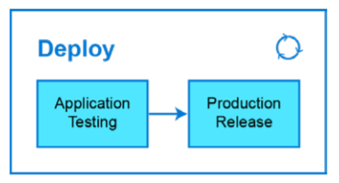
Concepts and workflow of MLOps
Application testing: Before deploying an ML model to production, it is vital to test its robustness and performance via testing. Hence we have the ‘application testing’ phase where we rigorously test all the trained models for robustness and performance in a production-like environment called a test environment. In the application testing phase, we deploy the models in the test environment (pre-production), which replicates the production environment.
Production release: Previously tested and approved models are deployed in the production environment for model inference to generate business or operational value. This production release is deployed to the production environment enabled by CI/CD pipelines.

Slide 13
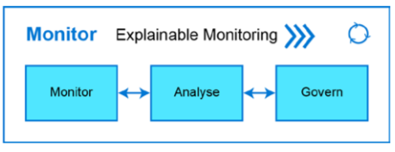
Concepts and workflow of MLOps
The monitor module works in sync with the deploy module. we can monitor, analyse and govern the deployed ML application (ML model and application). Firstly, we can monitor the performance of the ML model (using pre-defined metrics) and the deployed application (using telemetry data). Secondly, model performance can be analysed using a pre-defined explainability framework, and lastly, the ML application can be governed using alerts and actions based on the model’s quality assurance and control. This ensures a robust monitoring mechanism for the production system:

Slide 14
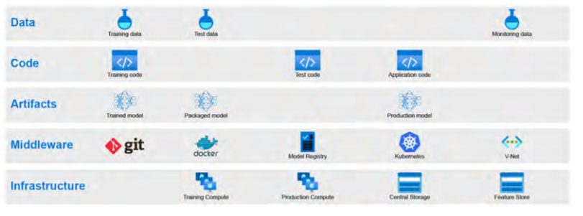
The MLOps pipeline
Drivers

Slide 15
Demo

